Slide 1
ETE 212/EEE 211
Introduction to Digital Electronics
Boolean Expressions and
Canonical Forms

Slide 2
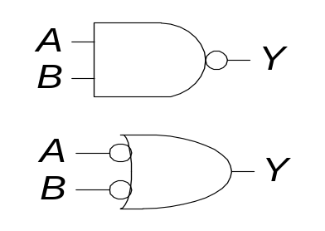
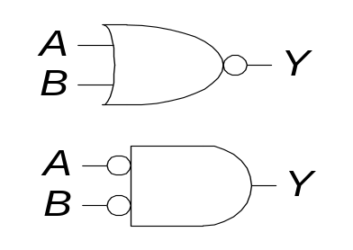
DeMorgan’s Theorem
Y = AB = A + B
Y = A + B = A B
1-<<number>>

Slide 3
Complementing Functions
Use DeMorgan's Theorem:
  1. Interchange AND and OR operators
  2. Complement each constant and literal
Example: Complement F =
F = (x + y + z)(x + y + z)
Example: Complement G = (a + bc)d + e
G = (a (b + c) + d) e
x
y
z
+
x
y
z
Notes:
G' = ((a (b' + c'))+ d ) e' = (a (b' + c') + d) e'

Slide 4
Expression Simplification
An application of Boolean algebra
Simplify to contain the smallest number of literals (variables that may or may not be complemented)
= AB + ABCD + A C D + A C D + A B D
= AB + AB(CD) + A C (D + D) + A B D
= AB + A C + A B D = B(A + AD) +AC
= B (A + D) + A C (has only 5 literals)
A
B
+
A
C
D
+
A
B
D
+
A
C
D
+
A
B
C
D

Slide 5
Canonical Forms
Minterms and Maxterms
Sum-of-Minterm (SOM) Canonical Form
Product-of-Maxterm (POM) Canonical Form
Representation of Complements of Functions
Conversions between Representations

Slide 6
Minterms
Minterms are AND terms with every variable present in either true or complemented form.
Given that each binary variable may appear normal (e.g., x) or complemented (e.g., ), there are 2^{n} minterms for n variables.
Example: Two variables (X and Y) produce
2 x 2 = 4 combinations:
  (both normal)
  (X normal, Y complemented)
  (X complemented, Y normal)
  (both complemented)
Thus there are four minterms of two variables.
x
XY
X
Y
X
Y
X
Y

Slide 7
Maxterms
Maxterms are OR terms with every variable in true or complemented form.
Given that each binary variable may appear normal (e.g., x) or complemented (e.g., x), there are 2^{n} maxterms for n variables.
Example: Two variables (X and Y) produce
2 x 2 = 4 combinations:
  (both normal)
  (x normal, y complemented)
  (x complemented, y normal)
  (both complemented)
X
+
Y
X
+
Y
X
+
Y
X
+
Y

Slide 8
Minterms & Maxterms for 2 variables
Two variable minterms and maxterms.
The minterm m_{i} should evaluate to 1 for each combination of x and y.
The maxterm is the complement of the minterm
x | y | Index | Minterm | Maxterm
0 | 0 | 0 | m₀ = x y | M₀ = x + y
0 | 1 | 1 | m₁ = x y | M₁ = x + y
1 | 0 | 2 | m₂ = x y | M₂ = x + y
1 | 1 | 3 | m₃ = x y | M₃ = x + y

Slide 9
Minterms & Maxterms for 3 variables
  x
  y
  z
  Index
Minterm
Maxterm
0
0
0
0
m0 = x y z
M0 = x + y + z
0
0
1
1
m1 = x y z
M1 = x + y + z
0
1
0
2
m2 = x y z
M2 = x + y + z
0
1
1
3
m3 = x y z
M3 = x + y + z
1
0
0
4
m4 = x y z
M4 = x + y + z
1
0
1
5
m5 = x y z
M5 = x + y + z
1
1
0
6
m6 = x y z
M6 = x + y + z
1
1
1
7
m7 = x y z
M7 = x + y + z
Maxterm M_{i} is the complement of minterm m_{i}
M_{i} = m_{i} and m_{i} = M_{i}

Slide 10
Purpose of the Index
Minterms and Maxterms are designated with an index
The index number corresponds to a binary pattern
The index for the minterm or maxterm, expressed as a binary number, is used to determine whether the variable is shown in the true or complemented form
For Minterms:
  ‘1’ means the variable is “Not Complemented” and
  ‘0’ means the variable is “Complemented”.
For Maxterms:
  ‘0’ means the variable is “Not Complemented” and
  ‘1’ means the variable is “Complemented”.

Slide 11
Standard Order
All variables should be present in a minterm or maxterm and should be listed in the same order (usually alphabetically)
Example: For variables a, b, c:
  Maxterms (a + b + c), (a + b + c) are in standard order
  However, (b + a + c) is NOT in standard order
  (a + c) does NOT contain all variables
  Minterms (a b c) and (a b c) are in standard order
  However, (b a c) is not in standard order
  (a c) does not contain all variables

Slide 12
Sum-Of-Minterm (SOM)
Sum-Of-Minterm (SOM) canonical form:
Sum of minterms of entries that evaluate to ‘1’
x | y | z | F | Minterm
0 | 0 | 0 | 0
0 | 0 | 1 | 1 | m₁ = x y z
0 | 1 | 0 | 0
0 | 1 | 1 | 0
1 | 0 | 0 | 0
1 | 0 | 1 | 0
1 | 1 | 0 | 1 | m₆ = x y z
1 | 1 | 1 | 1 | m₇ = x y z
Focus on the ‘1’ entries
F = m₁ + m₆ + m₇ = ∑ (1, 6, 7) = x y z + x y z + x y z

Slide 13
Sum-Of-Minterm Examples
F(a, b, c, d) = ∑(2, 3, 6, 10, 11)
F(a, b, c, d) = m₂ + m₃ + m₆ + m₁₀ + m₁₁
G(a, b, c, d) = ∑(0, 1, 12, 15)
G(a, b, c, d) = m₀ + m₁ + m₁₂ + m₁₅
a b c d
+ a b c d
+ a b c d
+ a b c d
+ a b c d
a b c d
+ a b c d
+ a b c d
+ a b c d
Notes:
F(A,B,C,D,E) = A’B’C’DE’ + A’BC’D’E + AB’C’D’E + AB’CDE

Slide 14
Product-Of-Maxterm (POM)
Product-Of-Maxterm (POM) canonical form:
Product of maxterms of entries that evaluate to ‘0’
x | y | z | F | Maxterm
0 | 0 | 0 | 1
0 | 0 | 1 | 1
0 | 1 | 0 | 0 | M₂ = (x + y + z)
0 | 1 | 1 | 1
1 | 0 | 0 | 0 | M₄ = (x + y + z)
1 | 0 | 1 | 1
1 | 1 | 0 | 0 | M₆ = (x + y + z)
1 | 1 | 1 | 1
Focus on the ‘0’ entries
F = M₂·M₄·M₆ = ∏ (2, 4, 6) = (x+y+z) (x+y+z) (x+y+z)

Slide 15
Product-Of-Maxterm Examples
F(a, b, c, d) = ∏(1, 3, 6, 11)
F(a, b, c, d) = M₁ · M₃ · M₆ · M₁₁
G(a, b, c, d) = ∏(0, 4, 12, 15)
G(a, b, c, d) = M₀ · M₄ · M₁₂ · M₁₅
(a+b+c+d)
(a+b+c+d)
(a+b+c+d)
(a+b+c+d)
(a+b+c+d)
(a+b+c+d)
(a+b+c+d)
(a+b+c+d)
Notes:
F(A,B,C,D,E) = A’B’C’DE’ + A’BC’D’E + AB’C’D’E + AB’CDE

Slide 16
Observations
We can implement any function by "ORing" the minterms corresponding to the ‘1’ entries in the function table. A minterm evaluates to ‘1’ for its corresponding entry.
We can implement any function by "ANDing" the maxterms corresponding to ‘0’ entries in the function table. A maxterm evaluates to ‘0’ for its corresponding entry.
The same Boolean function can be expressed in two canonical ways: Sum-of-Minterms (SOM) and Product-of-Maxterms (POM).
If a Boolean function has fewer ‘1’ entries then the SOM canonical form will contain fewer literals than POM. However, if it has fewer ‘0’ entries then the POM form will have fewer literals than SOM.

Slide 17
Converting to Sum-of-Minterms Form
A function that is not in the Sum-of-Minterms form can be converted to that form by means of a truth table
Consider F = y + x z
x | y | z | F | Minterm
0 | 0 | 0 | 1 | m₀ = x y z
0 | 0 | 1 | 1 | m₁ = x y z
0 | 1 | 0 | 1 | m₂ = x y z
0 | 1 | 1 | 0
1 | 0 | 0 | 1 | m₄ = x y z
1 | 0 | 1 | 1 | m₅ = x y z
1 | 1 | 0 | 0
1 | 1 | 1 | 0
F = ∑(0, 1, 2, 4, 5) =
m₀ + m₁ + m₂ + m₄ + m₅ =
x y z + x y z + x y z +
x y z + x y z

Slide 18
Converting to Product-of-Maxterms Form
A function that is not in the Product-of-Minterms form can be converted to that form by means of a truth table
Consider again: F = y + x z
x | y | z | F | Maxterm
0 | 0 | 0 | 1
0 | 0 | 1 | 1
0 | 1 | 0 | 1
0 | 1 | 1 | 0 | M₃ = (x+y+z)
1 | 0 | 0 | 1
1 | 0 | 1 | 1
1 | 1 | 0 | 0 | M₆ = (x+y+z)
1 | 1 | 1 | 0 | M₇ = (x+y+z)
F = ∏(3, 6, 7) =
M₃ · M₆ · M₇ =
(x+y+z) (x+y+z) (x+y+z)

Slide 19
Conversions Between Canonical Forms
x | y | z | F | Minterm | Maxterm
0 | 0 | 0 | 0 |  | M₀ = (x + y + z)
0 | 0 | 1 | 1 | m₁ = x y z
0 | 1 | 0 | 1 | m₂ = x y z
0 | 1 | 1 | 1 | m₃ = x y z
1 | 0 | 0 | 0 |  | M₄ = (x + y + z)
1 | 0 | 1 | 1 | m₅ = x y z
1 | 1 | 0 | 0 |  | M₆ = (x + y + z)
1 | 1 | 1 | 1 | m₇ = x y z
F = m₁+m₂+m₃+m₅+m₇ = ∑(1, 2, 3, 5, 7) =
x y z + x y z + x y z + x y z + x y z
F = M₀ · M₄ · M₆ = ∏(0, 4, 6) = x+y+z)(x+y+z)(x+y+z)

Slide 20
Algebraic Conversion to Sum-of-Minterms
Expand all terms first to explicitly list all minterms
AND any term missing a variable v with (v + v)
Example 1: f = x + x y (2 variables)
f = x (y + y) + x y
f = x y + x y + x y
f = m₃ + m₂ + m₀ = ∑(0, 2, 3)
Example 2: g = a + b c (3 variables)
g = a (b + b)(c + c) + (a + a) b c
g = a b c + a b c + a b c + a b c + a b c + a b c
g = a b c + a b c + a b c + a b c + a b c
g = m₁ + m₄ + m₅ + m₆ + m₇ = ∑ (1, 4, 5, 6, 7)

Slide 21
Algebraic Conversion to Product-of-Maxterms
Expand all terms first to explicitly list all maxterms
OR any term missing a variable v with v · v
Example 1: f = x + x y (2 variables)
Apply 2nd distributive law:
f = (x + x) (x + y) = 1 · (x + y) = (x + y) = M₁
Example 2: g = a c + b c + a b (3 variables)
g = (a c + b c + a) (a c + b c + b) (distributive)
g = (c + b c + a) (a c + c + b) (x + x y = x + y)
g = (c + b + a) (a + c + b) (x + x y = x + y)
g = (a + b + c) (a + b + c) = M₅ . M₂ = ∏ (2, 5)

Slide 22
Function Complements
The complement of a function expressed as a sum of minterms is constructed by selecting the minterms missing in the sum-of-minterms canonical form
Alternatively, the complement of a function expressed by a Sum of Minterms form is simply the Product of Maxterms with the same indices
Example: Given F(x, y, z) = ∑ (1, 3, 5, 7)
F(x, y, z) = ∑ (0, 2, 4, 6)
F(x, y, z) = ∏ (1, 3, 5, 7)

Slide 23
Summary of Minterms and Maxterms
There are 2^{n} minterms and maxterms for Boolean functions with n variables.
Minterms and maxterms are indexed from 0 to 2^{n} – 1
Any Boolean function can be expressed as a logical sum of minterms and as a logical product of maxterms
The complement of a function contains those minterms not included in the original function
The complement of a sum-of-minterms is a product-of-maxterms with the same indices

Slide 24
Standard Forms
Standard Sum-of-Products (SOP) form: equations are written as an OR of AND terms
Standard Product-of-Sums (POS) form: equations are written as an AND of OR terms
Examples:
  SOP:
  POS:
These “mixed” forms are neither SOP nor POS
A
B
C
+
A
B
C
+
B
(A
+
B)
·
(A
+
B
+
C
)
·
C
(A
B
+
C)
(A
+
C)
A
B
C
+
A
C
(A
+
B)

Slide 25
Standard Sum-of-Products (SOP)
A sum of minterms form for n variables can be written down directly from a truth table.
  Implementation of this form is a two-level network of gates such that:
  The first level consists of n-input AND gates
  The second level is a single OR gate
This form often can be simplified so that the corresponding circuit is simpler.

Slide 26
Standard Sum-of-Products (SOP)
A Simplification Example:
Writing the minterm expression:
F = A B C + A B C + A B C + ABC + ABC
Simplifying:
F = A B C + A (B C + B C + B C + B C)
F = A B C + A (B (C + C) + B (C + C))
F = A B C + A (B + B)
F = A B C + A
F = B C + A
Simplified F contains 3 literals compared to 15
F
(
A
,
B
,
C
)
=
Σ
(
1
,
4
,
5
,
6
,
7
)

Slide 27
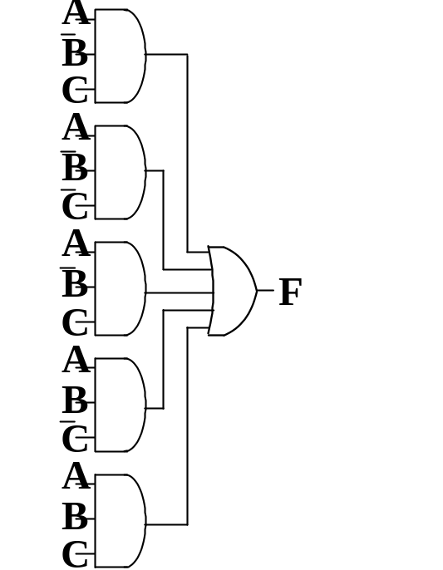
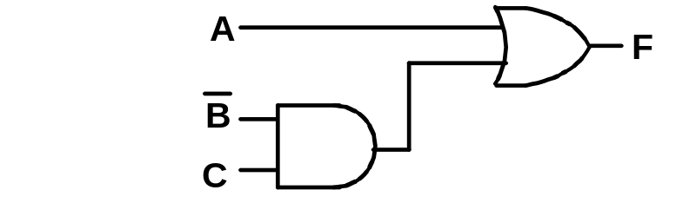
AND/OR Two-Level Implementation
The two implementations for F are shown below
It is quite apparent which is simpler!

Slide 28
SOP and POS Observations
The previous examples show that:
  Canonical Forms (Sum-of-minterms, Product-of-Maxterms), or other standard forms (SOP, POS) differ in complexity
  Boolean algebra can be used to manipulate equations into simpler forms
  Simpler equations lead to simpler implementations
Questions:
  How can we attain a “simplest” expression?
  Is there only one minimum cost circuit?
  The next part will deal with these issues

